Slide 1
Advance java – Multi Threading
Fresher Learning Program
January, 2012
Notes:
© 2006 Capgemini - All rights reserved

Slide 2
Objectives of Java Threads
Purpose:
  Understanding of threads and multithreading programs in Java
Product:
  To understand what is thread, and how it is different from process
  Two ways of creating thread in Java
  How to write multithreading programs in Java
  Concept of thread safety, and how to achieve it
  Various methods of thread class and inter thread communications
Process:
  Theory Sessions along with assignments
  A recap at the end of the session in the form of Quiz
© 2012 Capgemini - All rights reserved

Slide 3
Table of Contents
What is a thread?
Thread states
Two ways of creating Java threads
– Extending Thread class
– Implementing Runnable interface
Thread priorities
Thread class
Thread Group
Synchronization
Inter-thread communication
Scheduling a task via Timer and Timer Task
© 2012 Capgemini - All rights reserved

Slide 4
Threads
Why threads?
– Need to handle concurrent processes
Definition
– Single sequential flow of control within a program
– For simplicity, think of threads as processes executed by a program
– Example:
● Operating System
● Hot Java web browser
© 2012 Capgemini - All rights reserved
Notes:
Ver 1.0 © 2006 Capgemini - All rights reserved

Slide 5
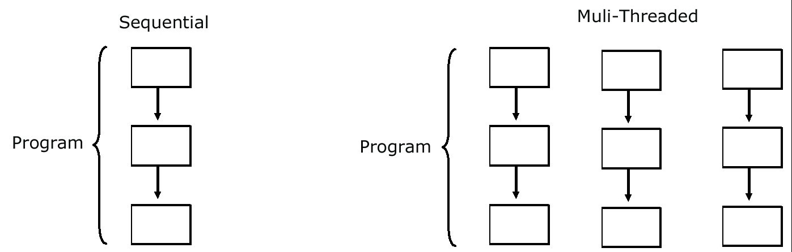
Threads
© 2012 Capgemini - All rights reserved
Notes:
Ver 1.0 © 2006 Capgemini - All rights reserved

Slide 6
Multi-threading in Java Platform
Every application has at least one thread — or several, if you count "system" threads that do things like memory management and signal
handling
But from the application programmer's point of view, you start with just one thread, called the main thread. This thread has the ability to create
additional threads
© 2012 Capgemini - All rights reserved
Notes:
Ver 1.0 © 2006 Capgemini - All rights reserved

Slide 7
Thread States
A thread can in one of several possible states:
1.Running Currently running In control of CPU
2.Ready to run Can run but not yet given the chance
3.Resumed Ready to run after being suspended or block
4.Suspended Voluntarily allowed other threads to run
5.Blocked Waiting for some resource or event to occur
© 2012 Capgemini - All rights reserved
Notes:
Ver 1.0 © 2006 Capgemini - All rights reserved

Slide 8
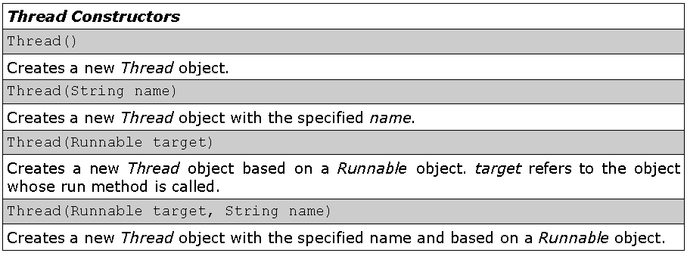
The Thread Class: Constructor
© 2012 Capgemini - All rights reserved
Notes:
Ver 1.0 © 2006 Capgemini - All rights reserved

Slide 9
Threads…
Two Ways of Creating and Starting a Thread
1.Extending the Thread class
2.Implementing the Runnable interface
© 2012 Capgemini - All rights reserved
Notes:
Ver 1.0 © 2006 Capgemini - All rights reserved

Slide 10
Extending Thread Class
The subclass extends Thread class
The subclass overrides the run() method of Thread class
An object instance of the subclass can then be created
Calling the start() method of the object instance starts the execution of the thread
Java runtime starts the execution of the thread by calling run() method of object instance
© 2012 Capgemini - All rights reserved
Notes:
Ver 1.0 © 2006 Capgemini - All rights reserved

Slide 11
Two Schemes of starting a thread from a subclass
Scheme #1: The start() method is not in the constructor of the subclass
– The start() method needs to be explicitly invoked after object instance of the subclass is created in order to start the thread
Scheme #2: The start() method is in the constructor of the subclass
– Creating an object instance of the subclass will start the thread
© 2012 Capgemini - All rights reserved
Notes:
Ver 1.0 © 2006 Capgemini - All rights reserved

Slide 12
Scheme #1: start() method is Not in the constructor of subclass
class PrintNameThread extends Thread {
PrintNameThread(String name) {
super(name);
}
public void run() {
String name = getName();
for (int i = 0; i < 100; i++) {
System.out.print(name);
}
}
}
© 2012 Capgemini - All rights reserved
Notes:
Ver 1.0 © 2006 Capgemini - All rights reserved

Slide 13
class ExtendThreadClassTest1 {
public static void main(String args[]) {
PrintNameThread pnt1 =new PrintNameThread("A");
pnt1.start(); // Start the first thread
PrintNameThread pnt2 = new PrintNameThread("B");
pnt2.start(); // Start the second thread
}
}
© 2012 Capgemini - All rights reserved
Notes:
Ver 1.0 © 2006 Capgemini - All rights reserved

Slide 14
Scheme #2: start() method is in aconstructor of the subclass
class PrintNameThread extends Thread {
PrintNameThread(String name) {
super(name);
start(); //runs the thread once instantiated
}
public void run() {
String name = getName();
for (int i = 0; i < 100; i++) {
System.out.print(name);
}
}
}
© 2012 Capgemini - All rights reserved
Notes:
Ver 1.0 © 2006 Capgemini - All rights reserved

Slide 15
class ExtendThreadClassTest2 {
public static void main(String args[]) {
PrintNameThread pnt1 = new PrintNameThread("A");
PrintNameThread pnt2 = new PrintNameThread("B");
}
}
class ExtendThreadClassTest3 {
public static void main(String args[]) {
new PrintNameThread("A");
new PrintNameThread("B");
}
}
© 2012 Capgemini - All rights reserved
Notes:
Ver 1.0 © 2006 Capgemini - All rights reserved

Slide 16
Implementing Runnable Interface
Runnable Interface
● The Runnable interface should be implemented by any class whose instances are intended to be executed as a thread
● The class must define run() method of no arguments
– The run() method is like main() for the new thread
● Provides the means for a class to be active while not sub classing Thread
– A class that implements Runnable can run without sub classing Thread by instantiating a Thread instance and passing itself in as the target
© 2012 Capgemini - All rights reserved
Notes:
Ver 1.0 © 2006 Capgemini - All rights reserved

Slide 17
Two Ways of Starting a Thread For a class that
Implements Runnable
Scheme #1: Caller thread creates Thread object and starts it explicitly after an object instance of the class that implements Runnable interface is created
– The start() method of the Thread object needs to be explicitly invoked after object instance is created
Scheme #2: The Thread object is created and started within the constructor method of the class that implements Runnable interface
– The caller thread just needs to create object instances of
the Runnable class
© 2012 Capgemini - All rights reserved
Notes:
Ver 1.0 © 2006 Capgemini - All rights reserved

Slide 18
Scheme #1:
PrintNameRunnable implements Runnable interface
class PrintNameRunnable implements Runnable {
String name;
PrintNameRunnable(String name) {
this.name = name;
}
// Implementation of the run() defined in the Runnable interface.
public void run() {
for (int i = 0; i < 10; i++) {
System.out.print(name);
}
}
}
© 2012 Capgemini - All rights reserved
Notes:
Ver 1.0 © 2006 Capgemini - All rights reserved

Slide 19
public class RunnableThreadTest1 {
public static void main(String args[]) {
PrintNameRunnable pnt1 = new PrintNameRunnable("A");
Thread t1 = new Thread(pnt1);
t1.start();
}
}
© 2012 Capgemini - All rights reserved
Notes:
Ver 1.0 © 2006 Capgemini - All rights reserved

Slide 20
Scheme #2:
// PrintNameRunnable implements Runnable interface
class PrintNameRunnable implements Runnable {
Thread thread;
PrintNameRunnable(String name) {
thread = new Thread(this, name);
thread.start();
}
// Implementation of the run() defined in the Runnable interface.
public void run() {
String name = thread.getName();
for (int i = 0; i < 10; i++) {
System.out.print(name);
}
}
}
© 2012 Capgemini - All rights reserved
Notes:
Ver 1.0 © 2006 Capgemini - All rights reserved

Slide 21
public class RunnableThreadTest2 {
public static void main(String args[]) {
/* Since the constructor of the PrintNameRunnable object
* creates a Thread object and starts it,
* there is no need to do it here.
*/
new PrintNameRunnable("A");
new PrintNameRunnable("B");
new PrintNameRunnable("C");
}
}
© 2012 Capgemini - All rights reserved
Notes:
Ver 1.0 © 2006 Capgemini - All rights reserved

Slide 22
Extending Thread vs. Implementing Runnable Interface
Choosing between these two is a matter of taste
● Implementing the Runnable interface
– May take more work since we still
- Declare a Thread object
- Call the Thread methods on this object
– Your class can still extend other class
● Extending the Thread class
– Easier to implement
– Your class can no longer extend any other class
© 2012 Capgemini - All rights reserved
Notes:
Ver 1.0 © 2006 Capgemini - All rights reserved

Slide 23
Thread Priorities
Why priorities?
– Determine which thread receives CPU control and getsto be executed first
Definition:
– Integer value ranging from 1 to 10
– Higher the thread priority → larger chance of being executed first
– Example:
● Two threads are ready to run
● First thread: priority of 5, already running
● Second thread = priority of 10, comes in while first thread is running
© 2012 Capgemini - All rights reserved
Notes:
Ver 1.0 © 2006 Capgemini - All rights reserved

Slide 24
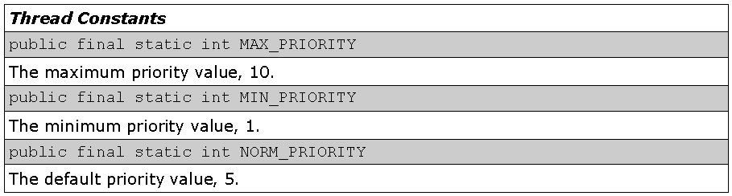
The Thread Class: Constants
Contains fields for priority values
© 2012 Capgemini - All rights reserved
Notes:
Ver 1.0 © 2006 Capgemini - All rights reserved

Slide 25
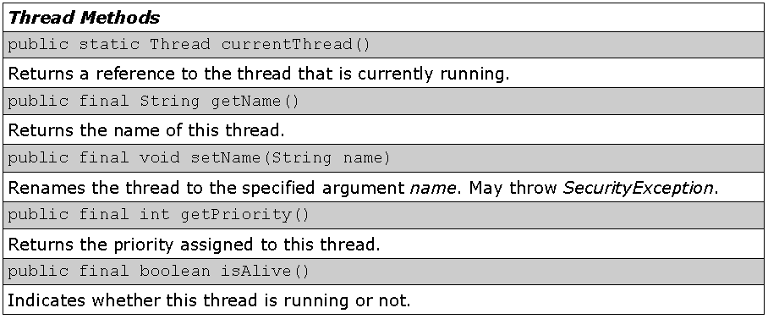
The Thread Class: Methods
Some Thread methods
© 2012 Capgemini - All rights reserved
Notes:
Ver 1.0 © 2006 Capgemini - All rights reserved

Slide 26
Synchronization
© 2012 Capgemini - All rights reserved
Notes:
Ver 1.0 © 2006 Capgemini - All rights reserved

Slide 27
Race condition & How to Solve it
Race conditions occur when multiple, asynchronously executing threads access the same object (called a shared resource) returning unexpected (wrong) results
Example:
– Threads often need to share a common resource ie a file, with one thread reading from the file while another thread writes to the file
- They can be avoided by synchronizing the threads which access the shared resource
© 2012 Capgemini - All rights reserved
Notes:
Ver 1.0 © 2006 Capgemini - All rights reserved

Slide 28
Synchronization:Locking an Object
A thread is synchronized by becoming an owner of the object's monitor
– Consider it as locking an object
A thread becomes the owner of the object's monitor in one of three ways
– Option 1: Use synchronized method
– Option 2: Use synchronized statement on a common object
© 2012 Capgemini - All rights reserved
Notes:
Ver 1.0 © 2006 Capgemini - All rights reserved

Slide 29
Use synchronized method
class TwoStrings {
synchronized static void print(String str1,
String str2) {
System.out.print(str1);
try {
Thread.sleep(500);
} catch (InterruptedException ie) {
}
System.out.println(str2);
}
}
//continued...
© 2012 Capgemini - All rights reserved
Notes:
Ver 1.0 © 2006 Capgemini - All rights reserved

Slide 30
class PrintStringsThread implements Runnable {
Thread thread;
String str1, str2;
PrintStringsThread(String str1, String str2) {
this.str1 = str1;
this.str2 = str2;
thread = new Thread(this);
thread.start();
}
public void run() {
TwoStrings.print(str1, str2);
}
}
© 2012 Capgemini - All rights reserved
Notes:
Ver 1.0 © 2006 Capgemini - All rights reserved

Slide 31
class TestThread {
public static void main(String args[]) {
new PrintStringsThread("Hello ", "there.");
new PrintStringsThread("How are ", "you?");
new PrintStringsThread("Thank you “, "very much!");
}
}
Executing SynchronizedMethod
Sample output:
Hello there.
How are you?
Thank you very much!
© 2012 Capgemini - All rights reserved
Notes:
Ver 1.0 © 2006 Capgemini - All rights reserved

Slide 32
Inter-thread Synchronization
© 2012 Capgemini - All rights reserved
Notes:
Ver 1.0 © 2006 Capgemini - All rights reserved

Slide 33
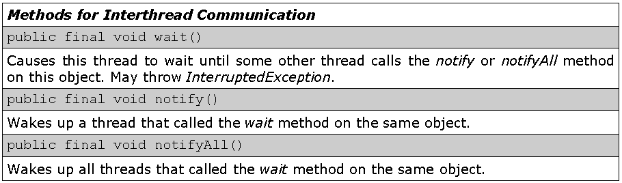
Methods related Inter thread communication
© 2012 Capgemini - All rights reserved
Notes:
Ver 1.0 © 2006 Capgemini - All rights reserved

Slide 34
wait() method of Object Class
wait() method causes a thread to release the lock it is holding on an object; allowing another thread to run
wait() method is defined in the Object class
wait() can only be invoked from within synchronizedcode
it should always be wrapped in a try block as it throws IOExceptions
wait() can only invoked by the thread that own's thelock on the object
© 2012 Capgemini - All rights reserved
Notes:
Ver 1.0 © 2006 Capgemini - All rights reserved

Slide 35
notify() method
Wakes up a single thread that is waiting on this object's monitor
– If any threads are waiting on this object, one of them is chosen to be awakened
– The choice is arbitrary and occurs at the discretion of the implementation
Can only be used within synchronized code
The awakened thread will not be able to proceed until the current thread relinquishes the lock on this object
© 2012 Capgemini - All rights reserved
Notes:
Ver 1.0 © 2006 Capgemini - All rights reserved

Slide 36
Timer Class
Provides a facility for threads to schedule tasks for future execution in a background thread
Tasks may be scheduled for one-time execution, or for repeated execution at regular intervals.
Corresponding to each Timer object is a single background thread that is used to execute all of the timer's tasks, sequentially
Timer tasks should complete quickly
– If a timer task takes excessive time to complete, it "hogs“ the timer's task execution thread. This can, in turn, delay the execution of subsequent tasks, which may "bunch
© 2012 Capgemini - All rights reserved
Notes:
Ver 1.0 © 2006 Capgemini - All rights reserved

Slide 37
Timer Class
up" and execute in rapid succession when (and if) the offending task finally completes.
Abstract class with an abstract method called run()
Concrete class must implement the run() abstract method
© 2012 Capgemini - All rights reserved
Notes:
Ver 1.0 © 2006 Capgemini - All rights reserved

Slide 38
Example: Timer Class
public class TimerReminder {
Timer timer;
public TimerReminder(int seconds) {
timer = new Timer();
timer.schedule(new RemindTask(), seconds*1000);
}
class RemindTask extends TimerTask {
public void run() {
System.out.format("Time's up!%n");
timer.cancel(); //Terminate the timer thread
}
}
public static void main(String args[]) {
System.out.format("About to schedule task.%n");
new TimerReminder(5);
System.out.format("Task scheduled.%n");
}
}
© 2012 Capgemini - All rights reserved
Notes:
Ver 1.0 © 2006 Capgemini - All rights reserved

Slide 39
Recap (Keywords)
sleep
wait Runnable
thread priority
dead lock
lock
yeild
blocked thread
timer class
synchronized block
© 2007 Capgemini - All rights reserved
Notes:
Recap – tips : To make it further lighter, many facilitator ask participant that they were allow to leave only if they will answer say 12 correct answers out of 15 questions. And then produce all recaps as questions.
© 2006 Capgemini - All rights reserved

Slide 40
Thank You For Your Time
Notes:
© 2006 Capgemini - All rights reserved

